Slide 1
Peering into the black box
How to apply model interpretability algorithms for fun and profit

Slide 2



Yigal Weinberger
Two M.Sc Degrees EE & ES
TAU researcher & Data Scientist
Intel SE & Data Scientist
Verint Data Scientist
Naya collage Lecturer
Palo Alto Networks Lead Data Scientist

Slide 3
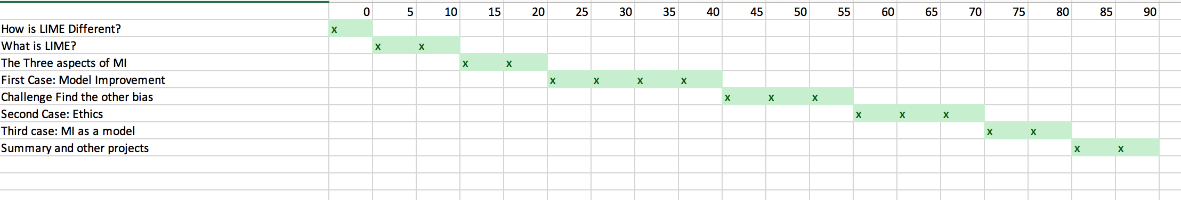
Our Plans for Today

Slide 4
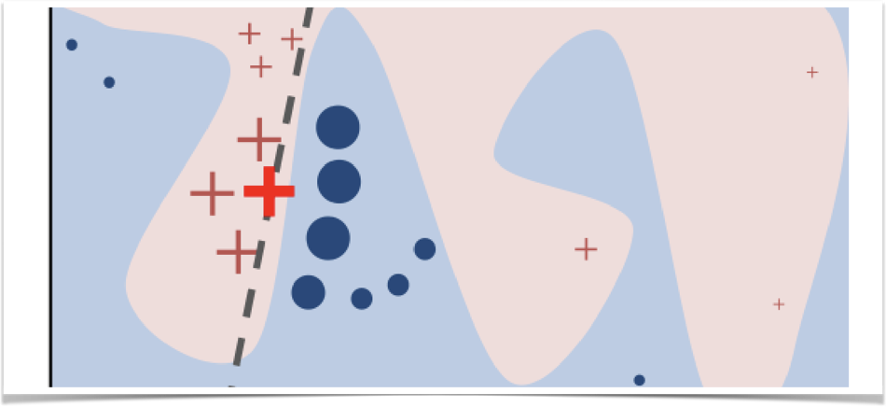
Create a local model
Assign more weight to nearby data points
Randomly sample from all data points
Use general model to mesure probability
Create a local model to interoperate examine data point

Slide 5
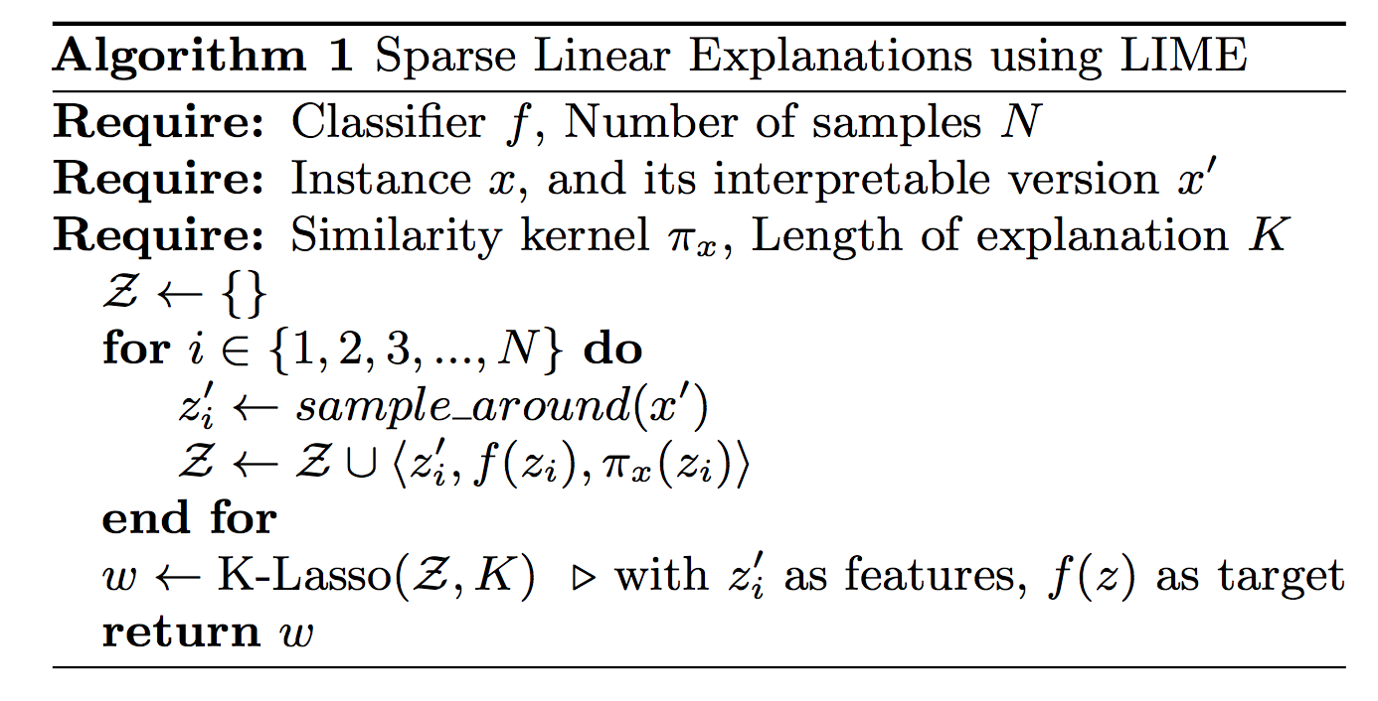
Algorithm to create a local model
Assign more weight to nearby data points
Randomly sample from all data points
Use general model to mesure probability
Create a local model to interoperate examine data point

Slide 6
Intuition
The actual feature importance may depend on the close proximity of the data point

Slide 7
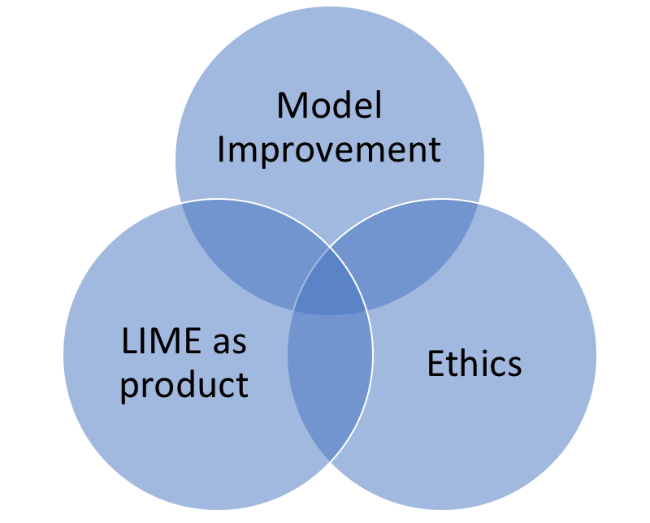
The three aspects of MI
Improving the model by removing bias features
Ethics & GDRP
Using the local model as the product

Slide 8
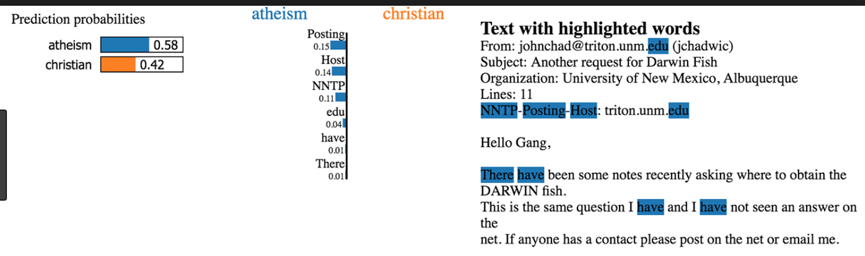
Model Improvement
Improving the model by removing bias features
Ethics & GDRP
Using the local model as the product

Slide 9
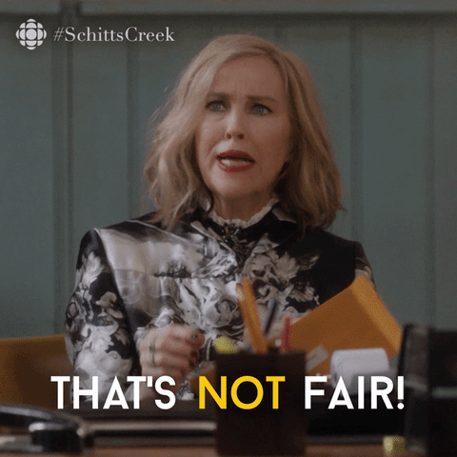
Model Improvement
Improving the model by removing bias features
Ethics & GDRP
Using the local model as the product

Slide 10
Ethics
GDPR “Right for explanation"
companies “should find simple ways to tell the data subject about the rationale behind, [… the decision …] not necessarily […] disclosure of the full algorithm.”

Slide 11
MI as the product
Providing explanations not predictions

Slide 12
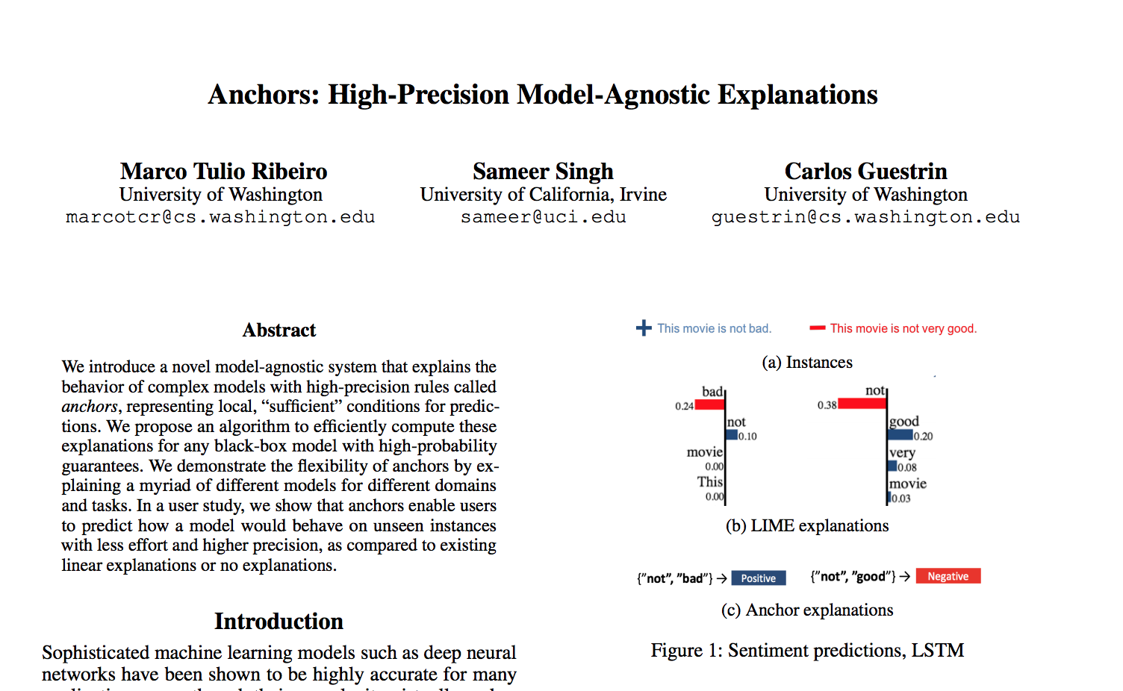
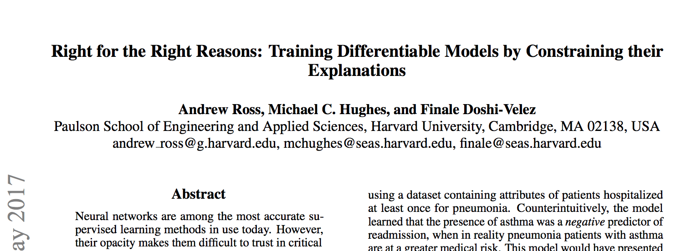
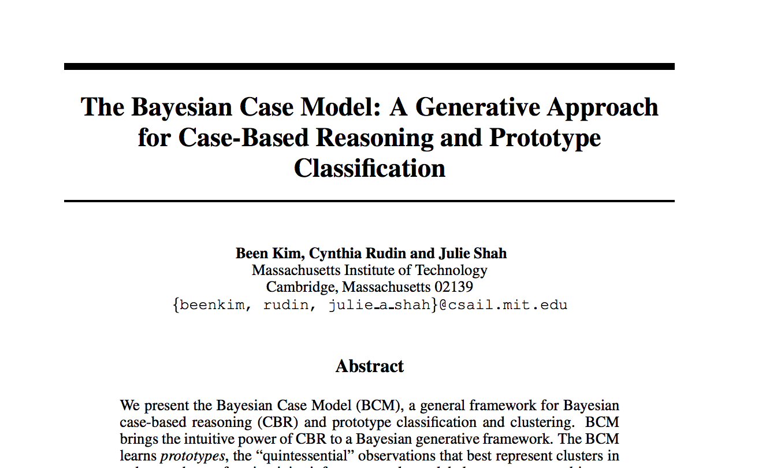
Other Solutions
Anchors
BCM
Right for the Right Reasons

Slide 13
Thank You!
Demo

